Slide 1
message authentication is concerned with:
protecting the integrity of a message
validating identity of originator
non-repudiation of origin (dispute resolution)

Slide 2
Security Requirements
disclosure
traffic analysis
masquerade
content modification
sequence modification
timing modification
source repudiation
destination repudiation
Notes:
‹#›
In the context of communications across a network, the attacks listed above can be identified.
The first two requirements belong in the realm of message confidentiality, and are handled using the encryption techniques already discussed.
The remaining requirements belong in the realm of message authentication. At its core this addresses the issue of ensuring that a message comes from the alleged source and has not been altered. It may also address sequencing and timeliness. The use of a digital signature can also address issues of repudiation by the source.
Stalling 5th ch 12 pg 389

Slide 3
Protocol for Message Transaction in Secure way
Confidentiality
Integrity
Authentication
Non repudiation
No replay

Slide 4
Message Integrity and Message Authentication

Slide 5
Message Integrity
Techniques we have discussed so far provides security or confidentiality but not integrity.
E.g death will
One way of document integrity is -signature or fingerprint .
Electronics equivalent of the document and fingerprint pair is the message and digest pair.

Slide 6
Msg
---
---
------
--------
-------------
Hash function
Message
digest

Slide 7
Checking Integrity
N
Msg
----=
------
---------
----------
Same?
Y
Hash
function
Current digest
Previous digest

Slide 8
Message Authentication
message authentication is concerned with:
protecting the integrity of a message
validating identity of originator
non-repudiation of origin (dispute resolution)
will consider the security requirements
then three alternative functions used:
message encryption
message authentication code (MAC)
hash function
Notes:
‹#›
Up untill now, have been concerned with protecting message content (ie secrecy) by encrypting the message. Will now consider how to protect message integrity (ie protection from modification), as well as confirming the identity of the sender. Generically this is the problem of message authentication, and in eCommerce applications is arguably more important than secrecy. Message Authentication is concerned with: protecting the integrity of a message, validating identity of originator, & non-repudiation of origin (dispute resolution). There are three types of functions that may be used to produce an authenticator: message encryption, message authentication code (MAC), or a hash function.
Stalling 5th ch 12 pg 389

Slide 9
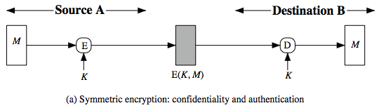
Message Encryption
message encryption by itself also provides a measure of authentication
if symmetric encryption is used then:
receiver know sender must have created it
since only sender and receiver know key used
know content cannot of been altered
if message has suitable structure, redundancy or a checksum to detect any changes
Notes:
‹#›
Message encryption by itself can provide a measure of authentication. Here, the ciphertext of the entire message serves as its authenticator, on the basis that only those who know the appropriate keys could have validly encrypted the message. This is provided you can recognize a valid message (ie if the message has suitable structure such as redundancy or a checksum to detect any changes).

Slide 10
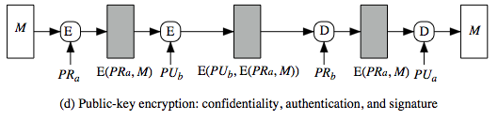
Message Encryption
if public-key encryption is used:
encryption provides no confidence of sender
since anyone potentially knows public-key
however if
sender signs message using their private-key
then encrypts with recipients public key
have both secrecy and authentication
again need to recognize corrupted messages
but at cost of two public-key uses on message
Notes:
‹#›
With public-key techniques, can get a digital signature which can only have been created by key owner. But at cost of two public-key operations at each end on message.

Slide 11
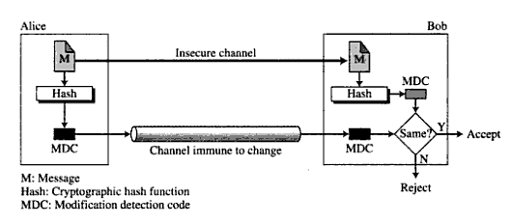
MDC

Slide 12
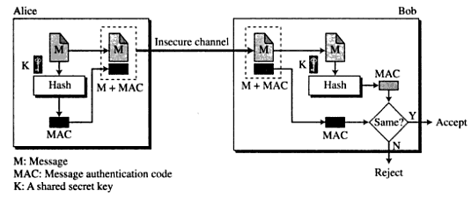
MAC

Slide 13
Security of MAC is dependent on underline hash algorithm

Slide 14
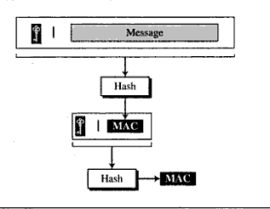
Nested MAC

Slide 15
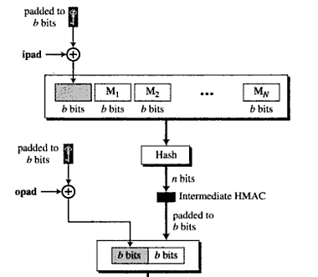
HMAC
Hash
n bit

Slide 16
H ((k+ xor opad) || H((k+ xor ipad) || M))
Ipad 36
Opad 5c

Slide 17
CMAC
CBC MAC

Slide 18
Using Symmetric Ciphers for MACs
can use any block cipher chaining mode and use final block as a MAC
Data Authentication Algorithm (DAA) is a widely used MAC based on DES-CBC
using IV=0 and zero-pad of final block
encrypt message using DES in CBC mode
and send just the final block as the MAC
or the leftmost M bits (16≤M≤64) of final block
but final MAC is now too small for security
Notes:
‹#›
Can also use block cipher chaining modes to create a separate authenticator, by just sending the last block. However this suffers from being a bit too small for acceptable use today.

Slide 19
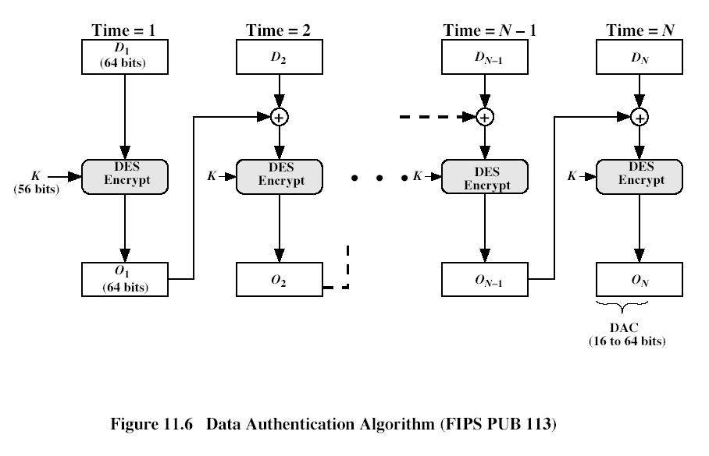
Notes:
‹#›

Slide 20
Hash Function

Slide 21
Hash Functions
condenses arbitrary message to fixed size
h = H(M)
usually assume that the hash function is public and not keyed
cf. MAC which is keyed
hash used to detect changes to message
can use in various ways with message
most often to create a digital signature
Notes:
‹#›
A variation on the message authentication code is the one-way hash function. As with the message authentication code, a hash function accepts a variable-size message M as input and produces a fixed-size output, referred to as a hash code H(M). Unlike a MAC, a hash code does not use a key but is a function only of the input message. The hash code is also referred to as a message digest or hash value.

Slide 22
Requirements for Hash Functions
can be applied to any sized message M
produces fixed-length output h
is easy to compute h=H(M) for any message M
given h is infeasible to find x s.t. H(x)=h
one-way property
given x is infeasible to find y s.t. H(y)=H(x)
weak collision resistance
is infeasible to find any x,y s.t. H(y)=H(x)
strong collision resistance
Notes:
‹#›
The purpose of a hash function is to produce a “fingerprint”of a file, message, or other block of data.
These are the specifications for good hash functions. Essentially it must be extremely difficult to find 2 messages with the same hash, and the hash should not be related to the message in any obvious way (ie it should be a complex non-linear function of the message). There are quite a few similarities in the evolution of hash functions & block ciphers, and in the evolution of the design requirements on both.

Slide 23
Simple Hash Functions
are several proposals for simple functions
based on XOR of message blocks
not secure since can manipulate any message and either not change hash or change hash also
need a stronger cryptographic function
Notes:
‹#›
All hash functions operate using the following general principles. The input (message, file,etc.) is viewed as a sequence of n-bit blocks, processed one block at a time in an iterative fashion to produce an n-bit hash function. Can construct a range of possible simple hash functions by just XOR’ing blocks with rotates etc. None of these are secure, since can predict how changes to message affect the resulting hash.

Slide 24
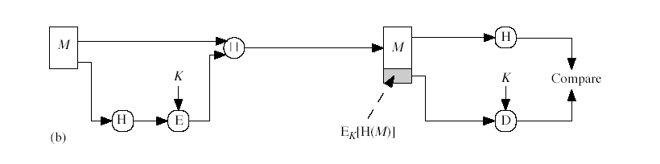
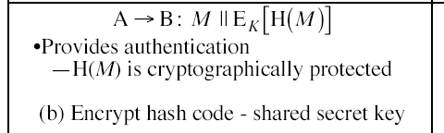
Notes:
‹#›

Slide 25
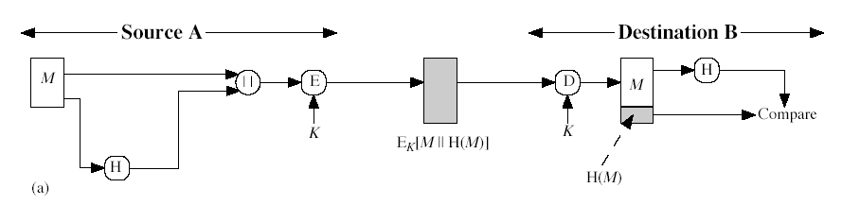
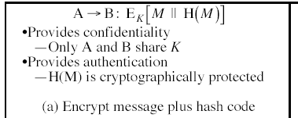
Notes:
‹#›

Slide 26
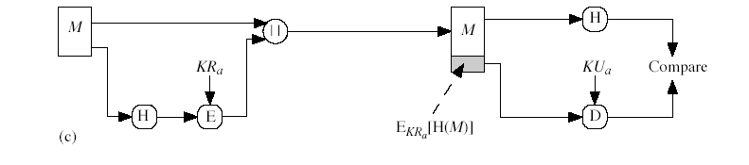
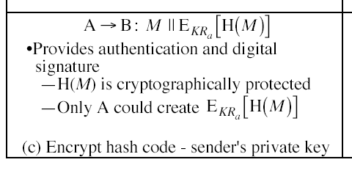
Notes:
‹#›

Slide 27
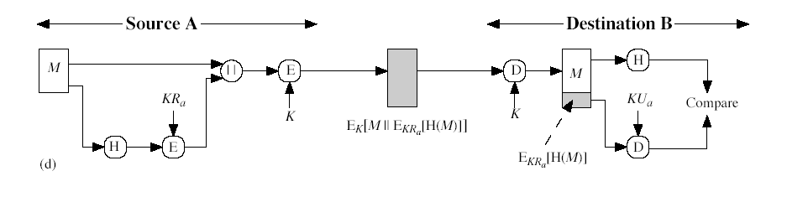
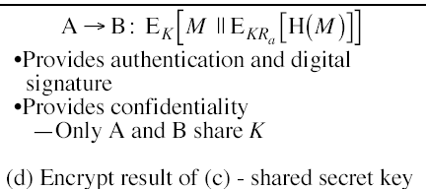
Notes:
‹#›

Slide 28
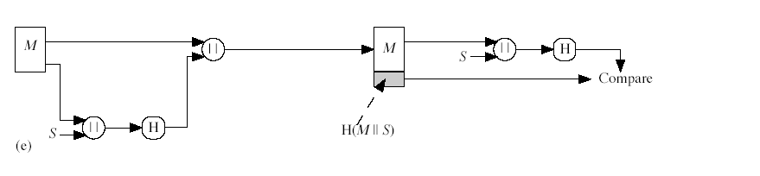
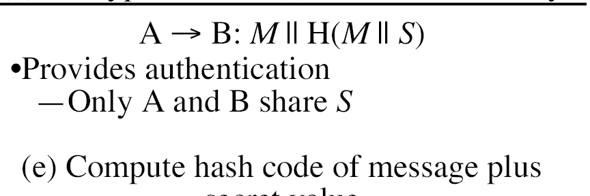
Notes:
‹#›

Slide 29
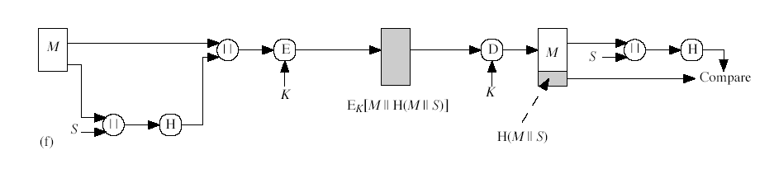
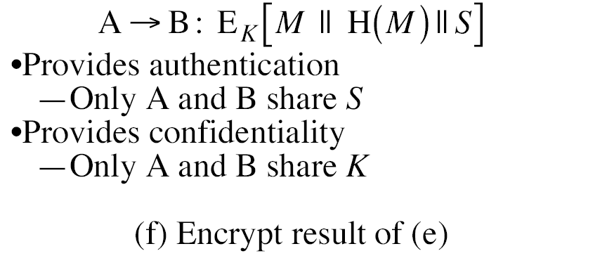
Notes:
‹#›

Slide 30
Use of hash
EK(M+H(M)) confidentiality , authentication
M+EK(H(M)) K SECRET KEY
H(M) encrypted public key and senders private key – digital sign.
SK(M+ PK(H(M))) – confidentiality and digital sign.
M + H(M+SK) – no encryption but uses secret key. Sk is already known.
Confidentiality can be added to the above approach by E(M+H(M)+S)

Slide 31
Birthday Attacks
might think a 64-bit hash is secure
but by Birthday Paradox is not
birthday attack works thus:
opponent generates 2^{m/2} variations of a valid message all with essentially the same meaning
opponent also generates 2^{m/2} variations of a desired fraudulent message
two sets of messages are compared to find pair with same hash (probability > 0.5 by birthday paradox)
have user sign the valid message, then substitute the forgery which will have a valid signature
conclusion is that need to use larger MAC/hash
Notes:
‹#›
The Birthday Attack exploits the birthday paradox – the chance that in a group of people two will share the same birthday – only 23 people are needed for a Pr>0.5 of this. Can generalize the problem to one wanting a matching pair from any two sets, and show need 2^{m/2} in each to get a matching m-bit hash.
Note that creating many message variants is relatively easy, either by rewording or just varying the amount of white-space in the message. All of which indicates that larger MACs/Hashes are needed.

Slide 32
MD2
128-bit message digest:
Arbitrary number of bytes of message
First pad to multiple of 16 bytes
Append MD2 checksum (16 bytes) to the end
The checksum is almost a MD, but not cryptographically secure by itself.
Process whole message
Notes:
‹#›

Slide 33
MD2 Checksum
One byte at a time, k × 16 steps
m_{nk}: byte nk of message
c_{n}=π(m_{nk} ⊕ c_{n-1}) ⊕ c_{n}
π : 0 → 41, 1 → 46, …
Substitution on 0-255 (value of the byte)
Notes:
‹#›

Slide 34
MD2 Final Pass
Operate on 16-byte chunks
48-byte quantity q:
(current digest|chunk|digest⊕chunk)
18 passes of massaging over q, and one byte at a time:
c_{n}=π(c_{n-1}) ⊕ c_{n} for n = 0, … 47; c₋₁ = 0 for pass 0; c₋₁ = (c₄₇ + pass #) mod 256
After pass 17, use first 16 bytes as new digest
16 × 8 = 128
Notes:
‹#›

Slide 35

MD5: Message Digest Version 5
input Message
Output 128 bits Digest
Notes:
‹#›

Slide 36
MD5 Box
512-bit message chunks (16 words)
Initial
128-bit vector
128-bit result
Notes:
‹#›

Slide 37
MD5 algorithm
Padding –
length is 64 bit less than an integer multiple of 512 bits.
If 448(64 bit less than 512) then padding is ? N
1000 ? Y (1472 64 less 1536 = 3*512)
512 ? Y
Append length –
64 bit length of msg , len mod 2⁶⁴ , data to hash = [Msg + padding +len]
Initialize MD buffer – chaining variable A,B,C,D – 32 bit no
Process message in 512 bit blocks –
Four rounds of processing on
i/p 512 bit data divided into 16 blocks of 32 bit each X[i]
chaining variable
uses one fourth of element table T[1---64] constructed from sin function 2^32 * abs(sin(i))\
process g (different for each round) F,G,H,I

Slide 38
MD5: Padding
1
2
3
4
input Message
512 bit block
Padding
Initial Value
MD5
Transformation block by block
Output 128 bits Digest
Final Output
Notes:
‹#›

Slide 39
MD5 Blocks
512: B₁
512: B₂
MD5
512: B₃
MD5
512: B₄
MD5
MD5
Result
Notes:
‹#›

Slide 40
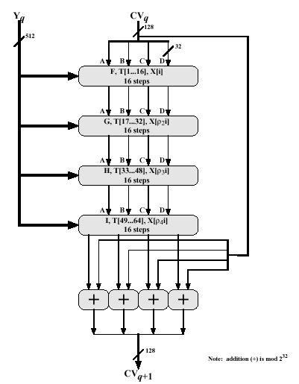
Step 4. Continued (4 Rounds)
‹#›

Slide 41
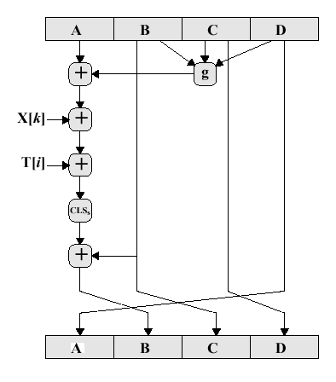
Step 4. Continued
‹#›

Slide 42
Functions and Random Numbers
One of the primitive function on (b,c,d)
Add a to above result
Add X[k]
Add T[i]
Circular left shift of 32 bit by s bits
Add b to the result (Add is modulo 2^32)
A=b+((a+P(b,c,d)+X[k]+T[i])<<<s)

Slide 43
1- F (b and c) or (not b and d)
2- G (b and d) or (c and d)
3- H b xor c xor d
4- I c xor (b or not d)

Slide 44

The MD5 Boolean Functions
The functions G, H, and I are similar to the function F, in that they
act in "bitwise parallel" to produce their output from the bits of X,
Y, and Z, in such a manner that if the corresponding bits of X, Y,
and Z are independent and unbiased, then each bit of G(X,Y,Z),
H(X,Y,Z), and I(X,Y,Z) will be independent and unbiased. Note that
the function H is the bit-wise "xor" or "parity" function of its
inputs.
‹#›

Slide 45
Strength of MD5
Every bit of hash code is function of every bit in the input.
To find message of given digest is order of 2^128 operations
Difficult to come up with the 2 messages having same hash
MD5 is vulnerable to birthday attack order 2^64

Slide 46
Secure Hash Algorithm
Developed by NIST, specified in the Secure Hash Standard (SHS, FIPS Pub 180), 1993
SHA is specified as the hash algorithm in the Digital Signature Standard (DSS), NIST manager

Slide 47
General Logic
Input message must be < 2⁶⁴ bits
not really a problem
Message is processed in 512-bit blocks sequentially
Message digest is 160 bits
SHA design is similar to MD5, but a lot stronger

Slide 48
Basic Steps
Step1: Padding
Step2: Appending length as 64 bit unsigned
Step3: Initialize MD buffer 5 32-bit words
A|B|C|D|E – big indian format
A = 67452301
B = efcdab89
C = 98badcfe
D = 10325476
E = c3d2e1f0

Slide 49
Basic Steps...
Step 4: the 80-step processing of 512-bit blocks – 4 rounds, 20 steps each.
Each step t (0 <= t <= 79):
Input:
W_{t} – a 32-bit word from the message
K_{t} – a constant.
ABCDE: current MD.
Output:
ABCDE: new MD.

Slide 50
Basic Steps...
Only 4 per-round distinctive additive constants
0 <=t<= 19 K_{t} = 5A827999
20<=t<=39 K_{t} = 6ED9EBA1
40<=t<=59 K_{t} = 8F1BBCDC
60<=t<=79 K_{t} = CA62C1D6

Slide 51
Basic Steps - The Heart Of The Matter
A
B
C
D
E
+
f_{t}
+
CLS5
W_{t}
+
CLS30
K_{t}
+
A
B
C
D
E

Slide 52
Basic Logic Functions
Only 3 different functions
Round Function f_{t}(B,C,D)
0 <=t<= 19 (B∧C)∨(~B ∧D)
20<=t<=39 B⊕C⊕D
40<=t<=59 (B∧C)∨(B∧D)∨(C∧D)
60<=t<=79 B⊕C⊕D

Slide 53
SHA 512

Slide 54
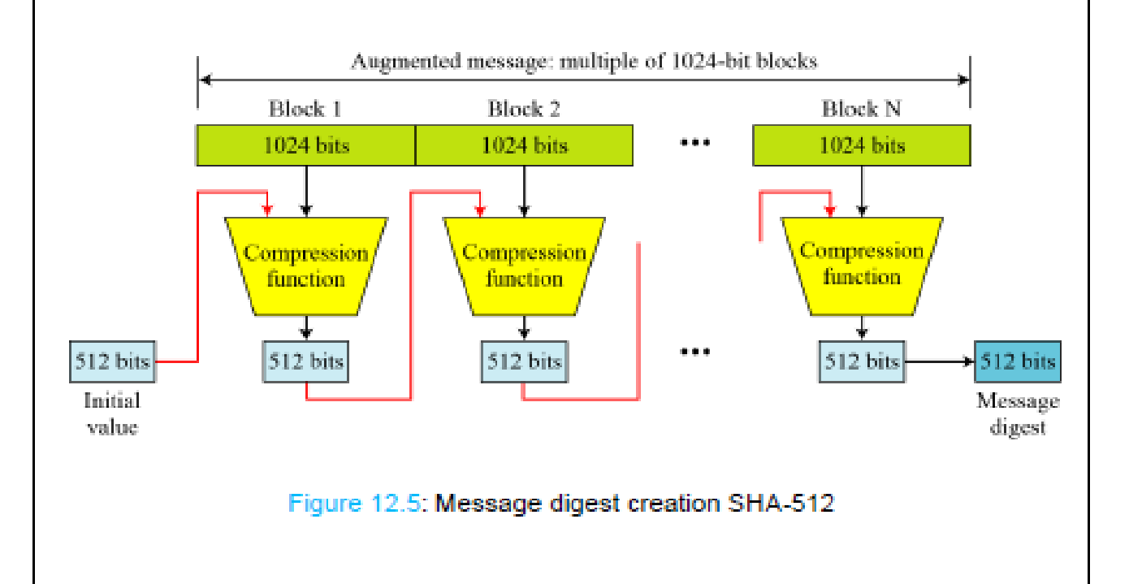

Slide 55
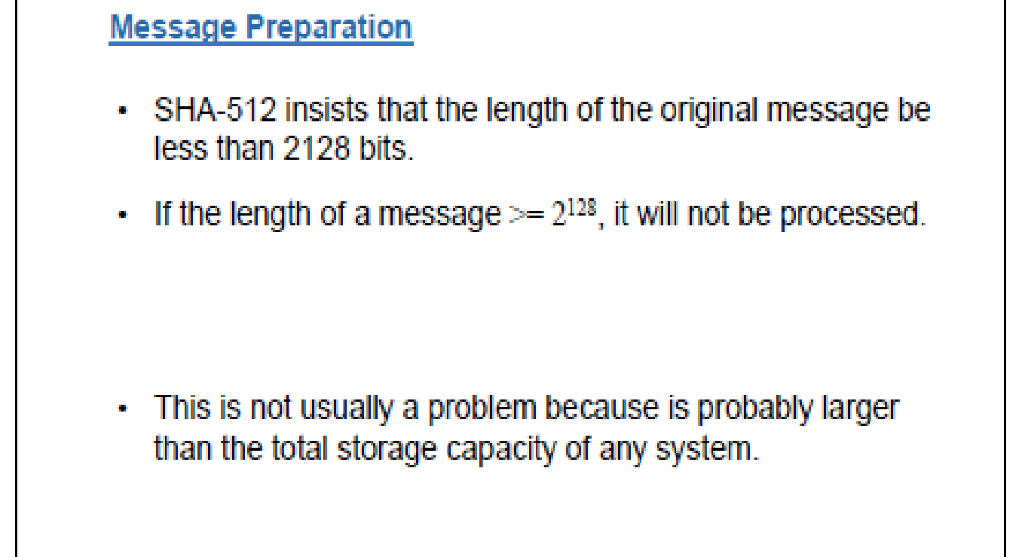

Slide 56
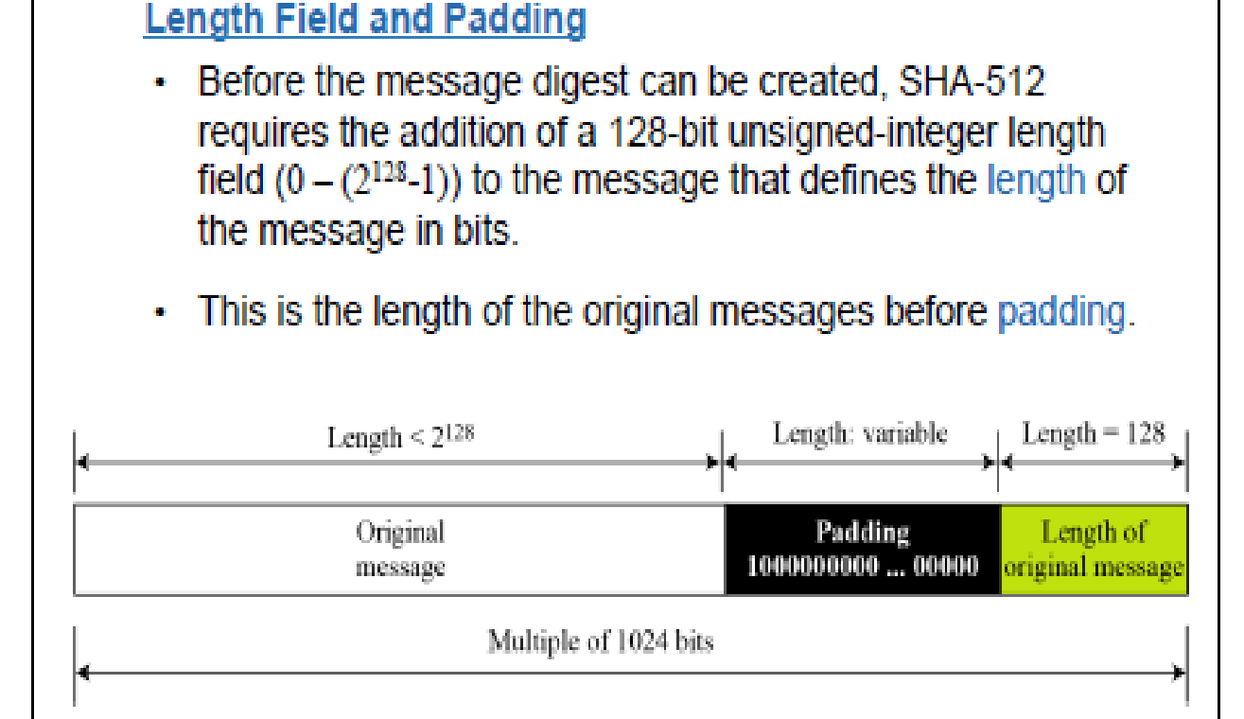

Slide 57
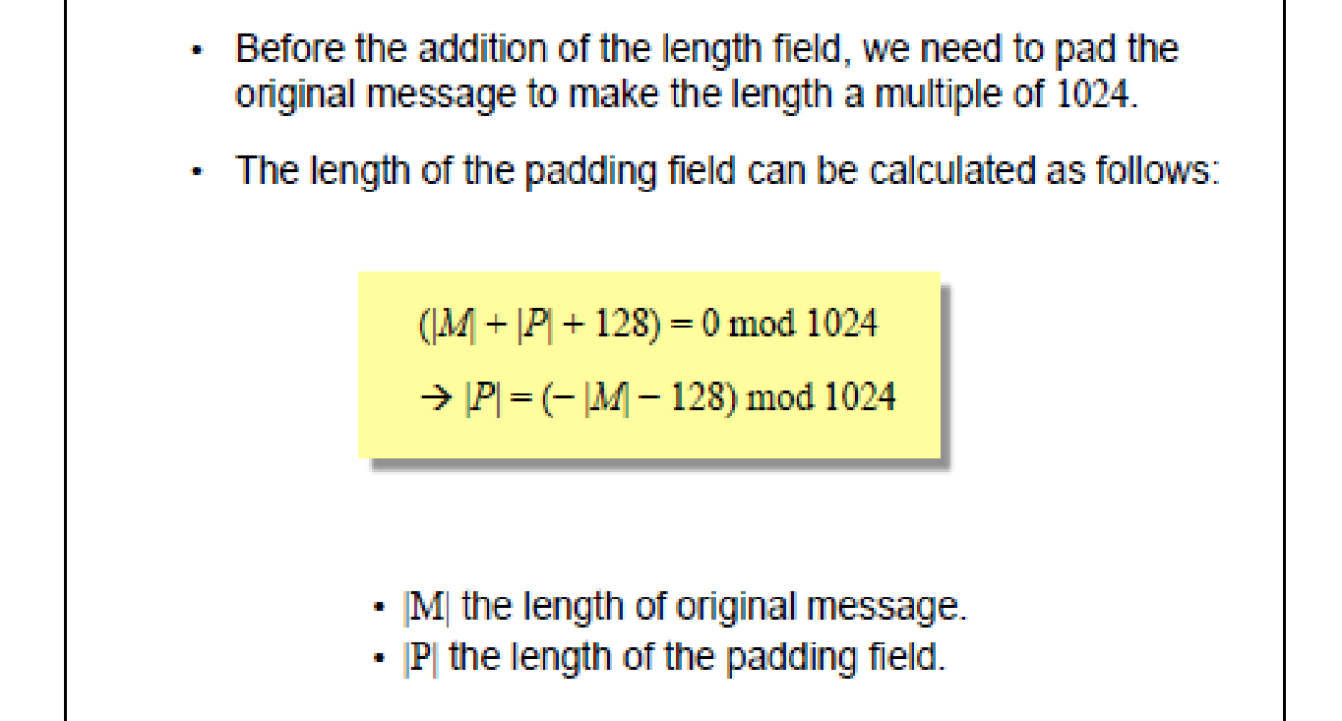

Slide 58
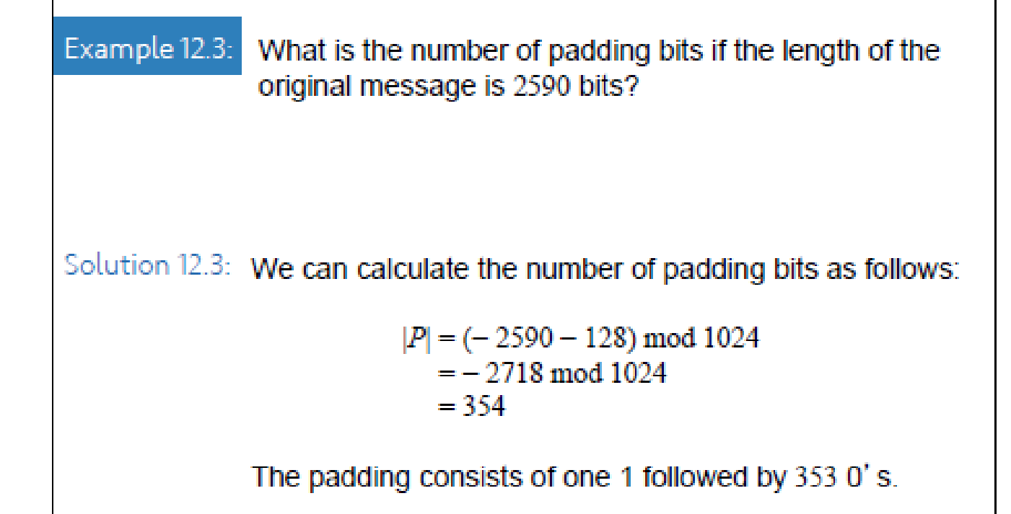

Slide 59
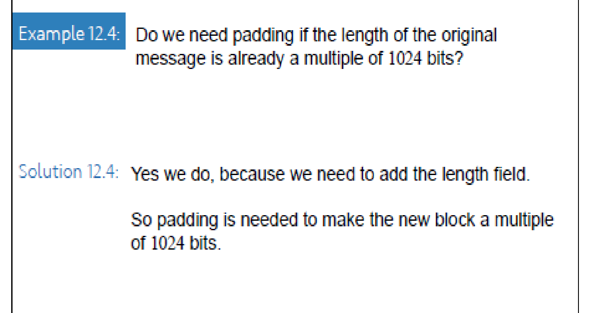

Slide 60
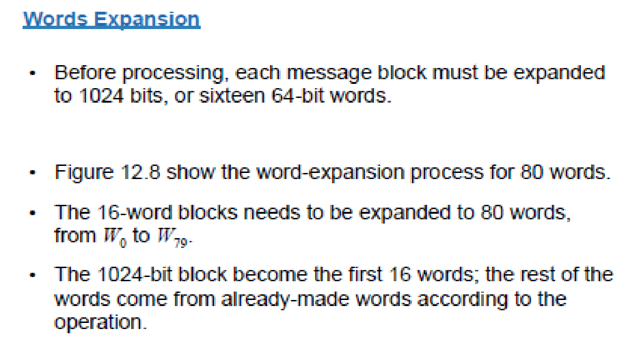

Slide 61
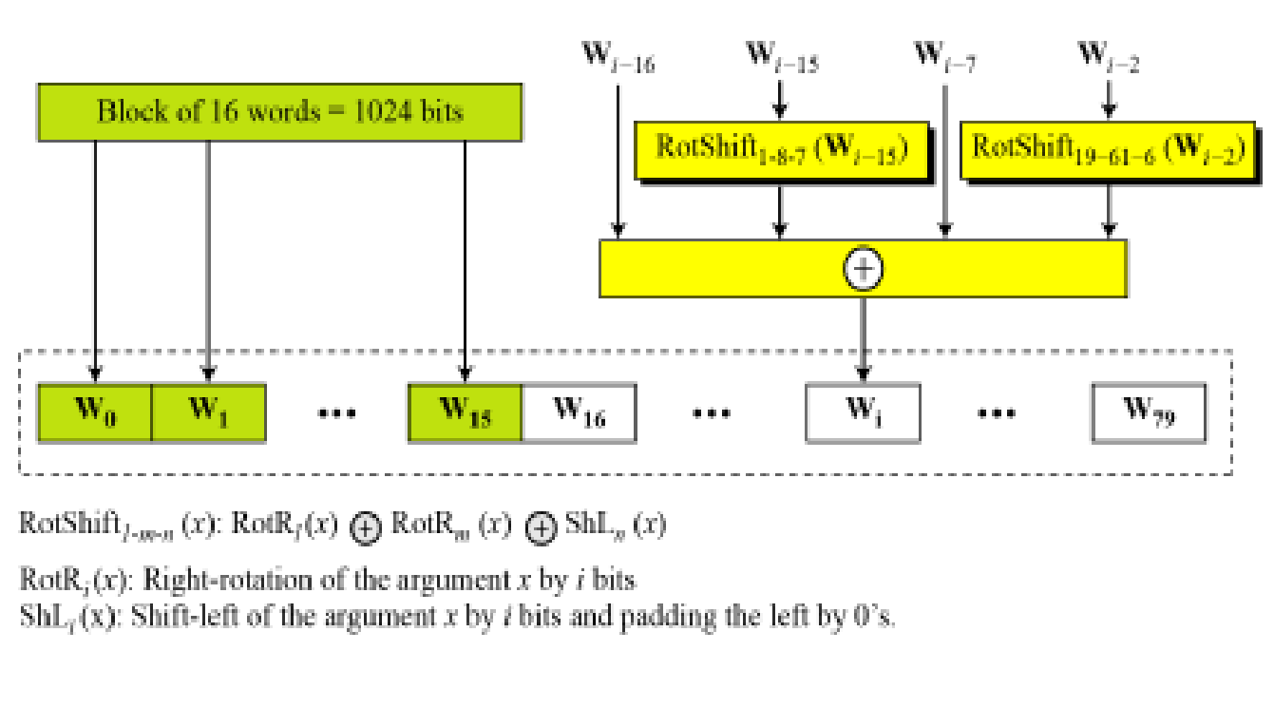

Slide 62
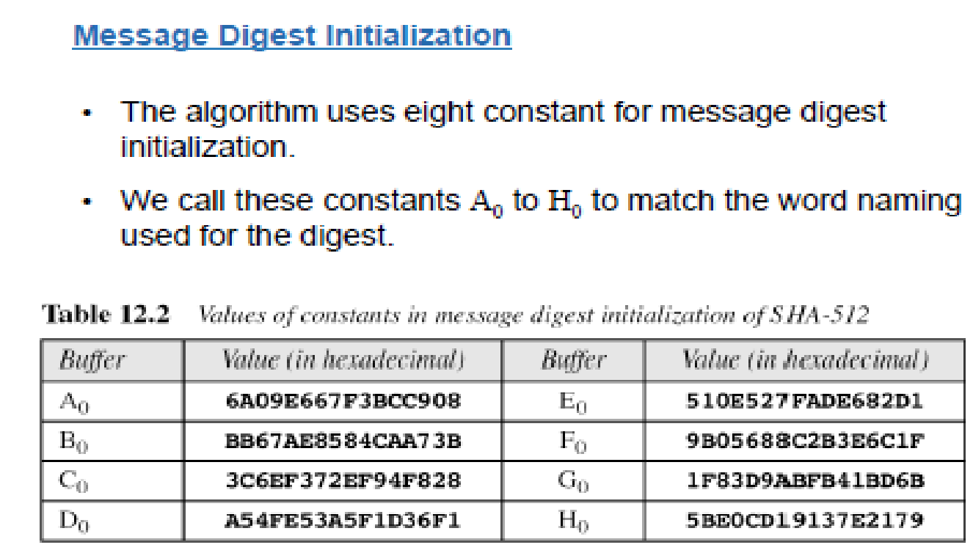

Slide 63
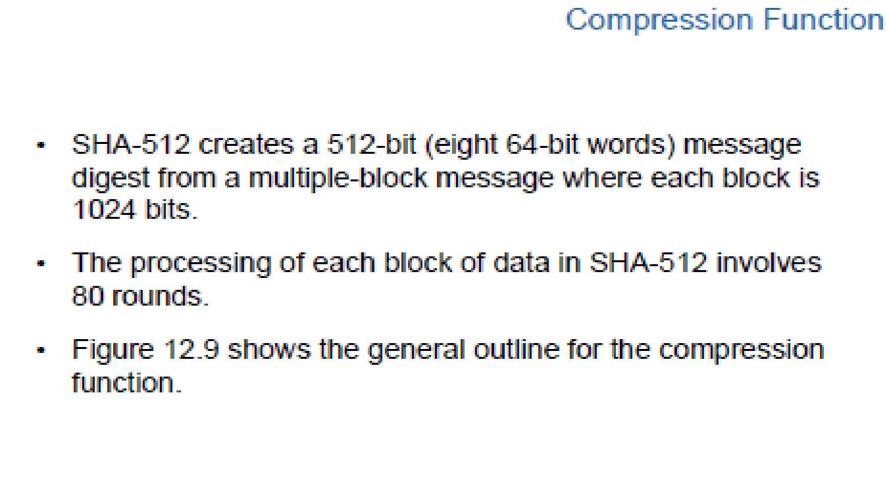

Slide 64
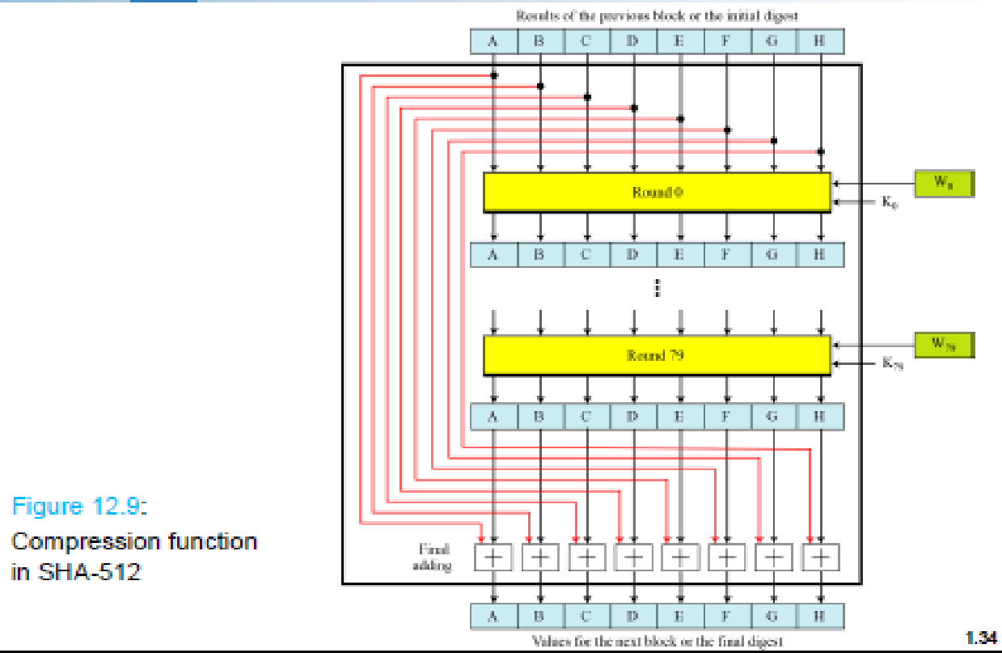

Slide 65
SHA-1 Message Digest
The message digest of the string:
“This is a test for theory of computation”
4480afca4407400b035d9debeb88bfc402db514f
Notes:
‹#›

Slide 66
SHA Versus MD5
SHA is a stronger algorithm:
Brute-force birthday attacks requires on the order of 2⁸⁰ operations vs. 2⁶⁴ for MD5
SHA’s 80 steps and 160 bits hash (vs. 128) requires a little more computation

Slide 67
Tiger hash
192-bit hash values
Tiger, which is designed to be both fast and secure.
Three rounds, each of which uses eight lookups into 8-to-64-bit S-boxes to provide a strong nonlinear avalanche plus a number of register operations to increase diffusion and make differential attacks harder

Slide 68
TigerM, or TigerM/N, where M is the number of passes, and N is the number of bits in the hash value

Slide 69
Security requirements
Deterministic hashing
Attacker chooses M, d=H(M)
Hashing with a random salt
Attacker chooses M, then good guy chooses public salt, d=H(salt,M)
Hashing random messages
M random, d=H(M)
Hashing with a secret key
Attacker chooses M, d=H(key,M)

Slide 70
Applications of hash

Slide 71
Using Hash for Authentication
Alice to Bob: challenge r_{A}
Bob to Alice: MD(K_{AB}|r_{A})
Bob to Alice: r_{B}
Alice to Bob: MD(K_{AB}|r_{B})
Only need to compare MD results
Notes:
‹#›

Slide 72
Using Hash to Encrypt
One-time pad:
compute bit streams using MD, K, and IV
b₁=MD(K_{AB}|IV), b_{i}=MD(K_{AB}|b_{i-1}), …
⊕ with message blocks
Or mixing in the plaintext
similar to cipher feedback mode (CFB)
b₁=MD(K_{AB}|IV), c₁= p₁ ⊕ b₁
b₂=MD(K_{AB}| c₁), c₂= p₂ ⊕ b₂
Notes:
‹#›

Slide 73
Using Secret Key for a Hash
Unix password algorithm:
Compute hash of user password, store the hash (not the password), and compare the hash of user-input password.
First 8 bytes of password used to form a secret key.
Encrypt 0 with a DES-like algorithm (why not use a “system” key to encrypt the password?).
Notes:
‹#›

